Slide 1

Introduction to environmental laws and regulation, Policy consideration: Environmental (Protection), Act, 1986
Information Security Fundamentals | Environmental Laws and Regulation
Course: Information Security Fundamentals | Chapter: Environmental Laws and Regulation | Program: Bachelor of Engineering
DISCOVER · LEARN · EMPOWER
Notes:
Welcome everyone to this session on Environmental Laws and Regulation. We will focus specifically on the foundational policies and the landmark Environmental Protection Act of 1986. This lecture is designed to help you understand the legal framework governing environmental security in India. Remember, our motto is Discover, Learn, and Empower as we explore these critical regulations.

Slide 2
Course Outcomes
SLIDE 2 / 14
Course Outcome
CO | BT LEVEL | DESCRIPTION
CO1 | BT4 | Recall, analyze and respond on fundamental environmental principles, such as ecological relationships and conservation strategies
CO2 | BT4 | Understand and analyze the interconnections between human activities and environmental impacts across different ecosystems
CO3 | BT4 | Understand and analyze and apply environmental laws and policies to analyse and propose solutions for real-world environmental challenges.
CO4 | BT2 | Students will analyse data from environmental monitoring programs to assess trends and predict future impacts on ecosystems.
CO5 | BT6 | Interpret, elaborate and propose various tools, design and innovative strategies for sustainable development and environmental conservation initiatives in securing the planet.
Chandigarh University
2 / 14
Notes:
Today's lecture directly addresses Course Outcome 5, which requires you to interpret and propose strategies for environmental conservation. You will learn how to analyze legal tools and design innovative strategies for sustainable development. This outcome emphasizes securing the planet through informed regulatory understanding. By the end of this session, you will be able to elaborate on these critical initiatives.

Slide 3
Learning Objectives
SLIDE 3 / 14
Learning Outcomes
1
Analyze the historical necessity and scope of environmental legislation in India.
2
Evaluate the specific provisions and powers granted under the EPA 1986.
3
Critique the effectiveness of regulatory mechanisms in preventing environmental degradation.
4
Propose innovative strategies for compliance with environmental protection standards.
5
Synthesize legal frameworks to support sustainable development initiatives in engineering.
Chandigarh University
3 / 14
Notes:
By the end of this lecture, you will be able to analyze the historical context of environmental laws in India. You will evaluate the specific powers granted to the government under the EPA 1986. We will also critique how effective these mechanisms are in preventing degradation. Finally, you will propose innovative strategies for compliance and sustainable development.

Slide 4
Lecture
SLIDE 4 / 14
Introduction to Environmental Laws
1
Environmental laws regulate human activities to prevent harm to natural ecosystems.
2
These laws establish standards for air, water, and soil quality protection.
3
Legal frameworks provide the basis for enforcement and penalty imposition.
4
International treaties influence domestic legislation and national policy development.
5
Regulations ensure sustainable use of resources for future generations.
Chandigarh University
4 / 14
Notes:
Environmental laws are essentially the rules of the road for our interaction with nature. They set strict standards for air, water, and soil to prevent pollution. Without these laws, industries could operate without regard for ecological damage. These regulations ensure that we use resources sustainably for future generations.

Slide 5
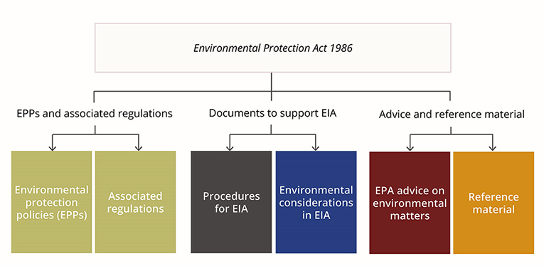
Lecture
SLIDE 5 / 14
Policy Considerations in Regulation
1
Policy considerations balance economic growth with ecological preservation needs.
2
Precautionary principle mandates action before scientific certainty of harm exists.
3
Polluter pays principle assigns financial responsibility for environmental damage.
4
Public participation ensures community voices influence regulatory decision-making.
5
Sustainable development integrates economic, social, and environmental goals.
Environmental Protection Authority's policy framework and key documents (source: www.wa.gov.au)
Chandigarh University
5 / 14
Notes:
Policy considerations are crucial for balancing economic growth with ecological preservation. The precautionary principle mandates action even before scientific certainty of harm exists. The polluter pays principle ensures that those causing damage bear the financial responsibility. Public participation ensures that community voices influence regulatory decision-making effectively.

Slide 6
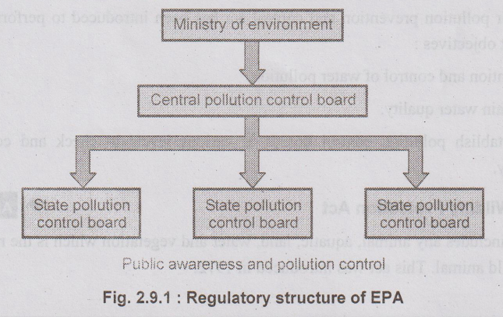
Lecture
SLIDE 6 / 14
Environmental Protection Act 1986 Overview
1
Enacted in 1986 following the Bhopal Gas Tragedy disaster.
2
Provides a comprehensive framework for environmental protection and management.
3
Empowers the central government to regulate industrial activities.
4
Establishes standards for emission and effluent discharge limits.
5
Creates mechanisms for public interest litigation and enforcement.
Environmental Protection Act (source: www.poriyaan.in)
Chandigarh University
6 / 14
Notes:
The Environmental Protection Act of 1986 was enacted following the tragic Bhopal Gas disaster. It provides a comprehensive framework for environmental protection and management across India. This act empowers the central government to regulate industrial activities effectively. It also establishes standards for emission and effluent discharge limits to protect public health.

Slide 7
Lecture
SLIDE 7 / 14
Key Provisions of EPA 1986
1
Section 3 grants powers to the central government for regulation.
2
Section 6 allows the government to issue binding environmental standards.
3
Section 18 empowers authorities to enter and inspect premises.
4
Section 19 mandates reporting of accidents and hazardous releases.
5
Section 21 provides for penalties for non-compliance with regulations.
Environmental Protection Authority's policy framework and key documents (source: www.wa.gov.au)
Chandigarh University
7 / 14
Notes:
Section 3 grants powers to the central government for regulation of environmental activities. Section 6 allows the government to issue binding environmental standards for industries. Section 18 empowers authorities to enter and inspect premises for compliance checks. Section 19 mandates reporting of accidents and hazardous releases to authorities.

Slide 8
Lecture
SLIDE 8 / 14
Regulatory Mechanisms and Enforcement
1
Central Pollution Control Board monitors compliance with environmental standards.
2
State Pollution Control Boards implement regulations at regional levels.
3
Environmental Impact Assessment is mandatory for major industrial projects.
4
Clearance procedures ensure projects meet environmental safety requirements.
5
Penalties include fines, imprisonment, and closure of non-compliant units.
Chandigarh University
8 / 14
Notes:
The Central Pollution Control Board monitors compliance with environmental standards nationwide. State Pollution Control Boards implement regulations at regional levels effectively. Environmental Impact Assessment is mandatory for major industrial projects before approval. Clearance procedures ensure that projects meet environmental safety requirements before operation.

Slide 9
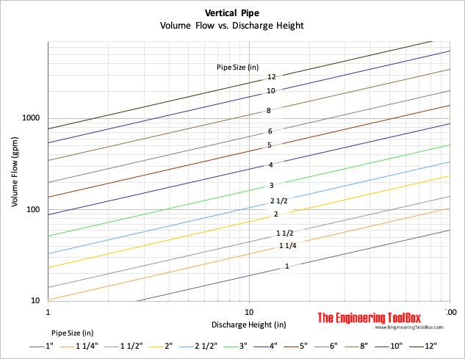
Worked Example
SLIDE 9 / 14
Compliance Calculation
GOVERNING EQUATION
Calculate total daily discharge: Q_total = Q_industry + Q_domestic
EXAMPLE
Q_industry = 500 m³/day, Q_domestic = 200 m³/day.
CHECK AGAINST LIMIT
700 m³/day ≤ 800 m³/day (Compliant).
EXCEEDING LIMIT TRIGGERS PENALTY
Fine = ₹5000 per day of violation.
• Total discharge = 500 + 200 = 700 m³/day.
Source: www.engineeringtoolbox.com
Chandigarh University
9 / 14
Notes:
Let's calculate total daily discharge for a hypothetical industrial unit. If Q_industry is 500 cubic meters per day and Q_domestic is 200 cubic meters per day, the total is 700 cubic meters per day. This is within the limit of 800 cubic meters per day, so the unit is compliant. Exceeding this limit would trigger a penalty of ₹5000 per day of violation.

Slide 10

Lecture
SLIDE 10 / 14
Common Pitfalls in Compliance
1
Ignoring cumulative effects of multiple small pollution sources.
2
Failing to update monitoring equipment for accurate data collection.
3
Overlooking seasonal variations in environmental carrying capacity limits.
4
Neglecting proper documentation for regulatory audits and inspections.
5
Assuming grandfather clauses protect outdated industrial practices indefinitely.
Source: static.vecteezy.com
Chandigarh University
10 / 14
Notes:
A common pitfall is ignoring the cumulative effects of multiple small pollution sources. Failing to update monitoring equipment can lead to inaccurate data collection and false compliance. Engineers must also overlook seasonal variations in environmental carrying capacity limits. Neglecting proper documentation for regulatory audits can lead to severe penalties.

Slide 11

Lecture
SLIDE 11 / 14
Role of Public Interest Litigation
1
Public Interest Litigation allows citizens to seek judicial intervention.
2
Courts can issue directions for environmental protection and remediation.
3
Litigation has led to landmark rulings on air and water quality.
4
Citizens can file cases against government inaction on pollution.
5
Judicial activism strengthens enforcement of environmental laws significantly.
Source: static.vecteezy.com
Chandigarh University
11 / 14
Notes:
Public Interest Litigation allows citizens to seek judicial intervention for environmental issues. Courts can issue directions for environmental protection and remediation of damaged areas. Litigation has led to landmark rulings on air and water quality standards. Citizens can file cases against government inaction on pollution effectively.

Slide 12
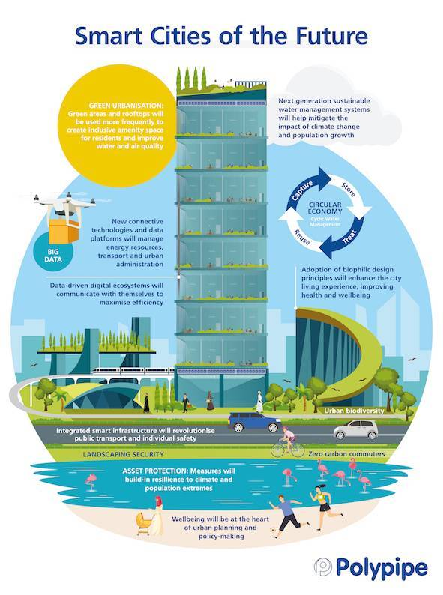
Lecture
SLIDE 12 / 14
Innovative Strategies for Conservation
1
Implement real-time monitoring systems for continuous pollution tracking.
2
Adopt circular economy principles to minimize waste generation.
3
Utilize green technology for cleaner production processes and operations.
4
Develop community-based conservation programs for local engagement.
5
Integrate environmental education into engineering curriculum and training.
Source: middleeast.polypipe.com
Chandigarh University
12 / 14
Notes:
We can implement real-time monitoring systems for continuous pollution tracking and management. Adopting circular economy principles helps minimize waste generation in industrial processes. Utilizing green technology ensures cleaner production processes and operations. Developing community-based conservation programs fosters local engagement and support.

Slide 13
Lecture
SLIDE 13 / 14
Key Takeaways
1
Environmental laws provide the legal framework for ecosystem protection.
2
EPA 1986 is the cornerstone of Indian environmental regulation.
3
Regulatory mechanisms include monitoring, assessment, and penalty enforcement.
4
Compliance requires accurate calculations and proactive documentation practices.
5
Innovative strategies are essential for sustainable development and conservation.
Environmental Protection Authority's policy framework and key documents (source: www.wa.gov.au)
Chandigarh University
13 / 14
Notes:
Environmental laws provide the essential legal framework for ecosystem protection and management. The EPA 1986 remains the cornerstone of Indian environmental regulation today. Regulatory mechanisms include monitoring, assessment, and penalty enforcement for compliance. Innovative strategies are essential for sustainable development and long-term conservation efforts.

Slide 14
Lecture
SLIDE 14 / 14
References
ENVIRONMENTAL STUDIES
From Crisis to Cure — R. Rajagopalan
• Environmental Science and Engineering — Benny Joseph
• Environmental Studies — R.C. Sharma and D. Gurbir Sangha
• Introduction to Environmental Science — Anjaneyulu, Y.
• Environmental Pollution Control Engineering — C.S. Rao
• Textbook of Environmental Studies for undergraduate courses — E. Bharucha
• Environmental Science — S.C. Santra
Chandigarh University
14 / 14
Notes:
These reference books provide comprehensive coverage of environmental science and engineering principles. Benny Joseph's work offers detailed insights into environmental engineering practices. R.C. Sharma and D. Gurbir Sangha provide a broad overview of environmental studies. Anjaneyulu, Y. and C.S. Rao offer specialized knowledge in pollution control.

